Slide 1
Software Experiment 3 Project #3
2011314271 최동혁
2011312805 송재현

Slide 2
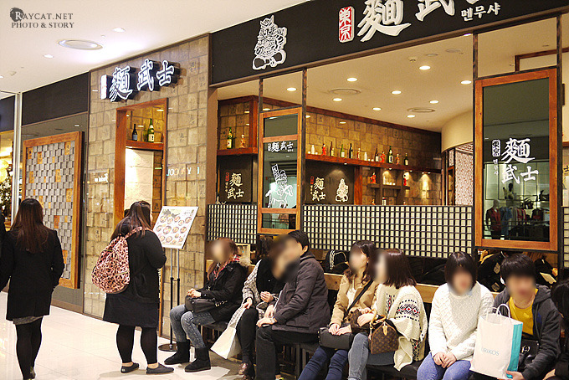
Store Information Service

Slide 3
Multi Client Single Server
Client
Client
Client
Client
Server
Client
Client
Client
Client
Client
Client

Slide 4
Multi Database Single Server
DB
DB
DB
DB
Server
DB
DB
DB
DB
DB
DB

Slide 5
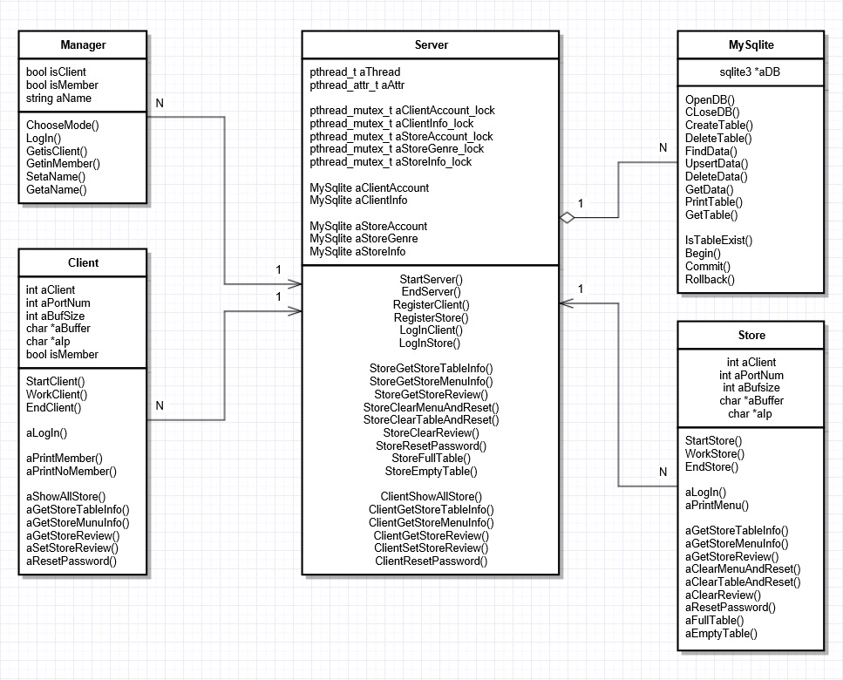
UML

Slide 6
Server
StartServer
EndServer
RegisterClient
RegisterStore
LogInCLient
LogInStore
StoreGetStoreTableInfo
StoreGetStoreMenuInfo
StoreGetStoreReview
StoreClearMenuAndReset
StoreClearTableAndReset
StoreClearReview
StoreResetPassword
StoreFullTable
StoreEmptyTable
ClientShowAllStore
ClientGetStoreTableInfo
ClientGetStoreMenuInfo
ClientGetStoreReview
ClientSetStoreReview
ClientResetPassword

Slide 7
Client(Customer)
StartClient
EndClient
WorkClient
aLogIn
aPrintMember
aPrintNoMember
aShowAllStore
aGetStoreTableInfo
aGetStoreMenuInfo
aGetStoreReview
aSetStoreReview
aResetPassword0

Slide 8
Client(Restaurant)
StartStore
EndStore
WorkStore
aLogIn
aPrintMenu
aGetStoreTableInfo
aGetStoreMenuInfo
aGetStoreReview
aClearMenuAndReset
aClearTableAndReset
aClearReview
aResetPassword
aFullTable
aEmptyTable

